Slide 1


Nassau County
Health Summit and Update on MAPP Health Assessments
September 26, 2018
Presented by: Mary von Mohr, vFlorida Department of Health-Nassau
and the Partnership for Healthier Nassau (PHN)

Slide 2

Meeting Agenda
1:00-2:00 Nassau Health Summit
2:00-4:00 Update on Health Data
Selection of new CHIP Issues for 2019-2021
4:00-5:00 Summary

Slide 3
Our GOAL is to leave knowing
What you think are the most concerning health issues in Nassau County
What do you want to change?

Slide 4
Poll Everywhere Directions
Open your web browser on your smartphone and go to:
PollEv.com/nassauhealth453
or
2. Text NASSAUHEALTH453 to 22333

Slide 5
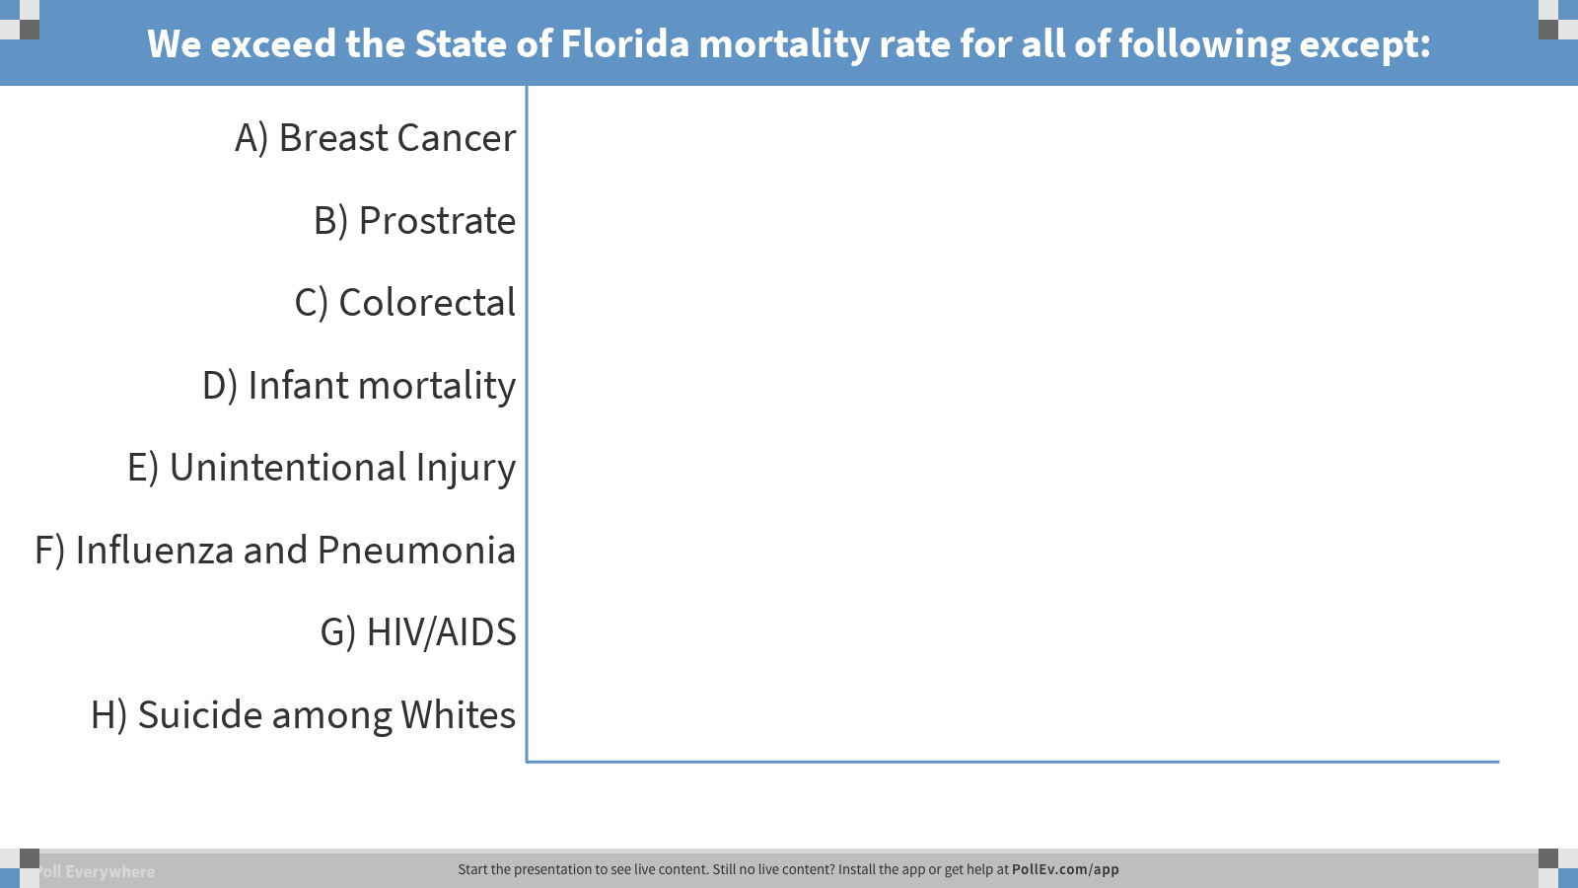
Notes:
Poll Title: We exceed the State of Florida mortality rate for all of following except:
https://www.polleverywhere.com/multiple_choice_polls/ZofzvYYK4Tt1p4C

Slide 6

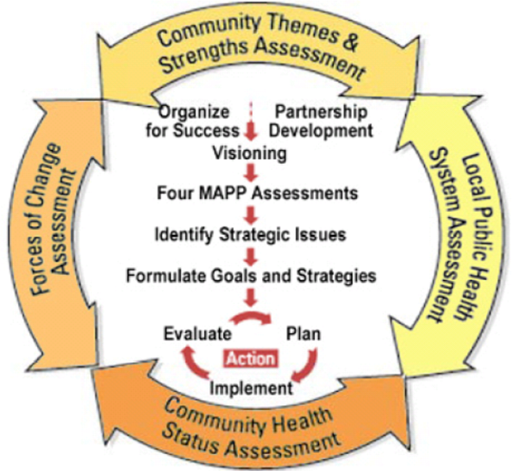
Nassau CHIP and Agenda
MAPP Process: Step three of six
Present new assessment results
Group Discussion
Prioritize and Vote on top 3-5 Issues
Recruit for Workgroup members
Oct-Dec Plan Development – Goals
January 2019 – share new CHIP

Slide 7
What did we learn from the
Four Assessments?
Community Health Assessment 2018
Community Themes and Strengths
Local Public Health System Assessment
Forces of Change

Slide 8
Content of Health Assessment
Demographic Profile
Major Causes of Death
Communicable Disease
Maternal & Child Health
Injury & Violence
Social & Behavioral Health
Health Behaviors
Access to Health Care Resources
Health Disparities
Create by the Health Planning Council of Northeast Florida

Slide 9
Reading Data Slides
Trend differences as related to:
  Age
  Race
  Gender
  Zip code
  Ethnic Group
  Economic Status
The PHN Steering Committee found health disparities within the areas of:
  Cancer
  Infant mortality
  Low birthweight
  Chronic disease (diabetes/stroke)
  HIV w/non-white

Slide 10
Poll Everywhere Directions
Open your web browser on your smartphone and go to:
PollEv.com/nassauhealth453
or
2. Text NASSAUHEALTH453 to 22333

Slide 11
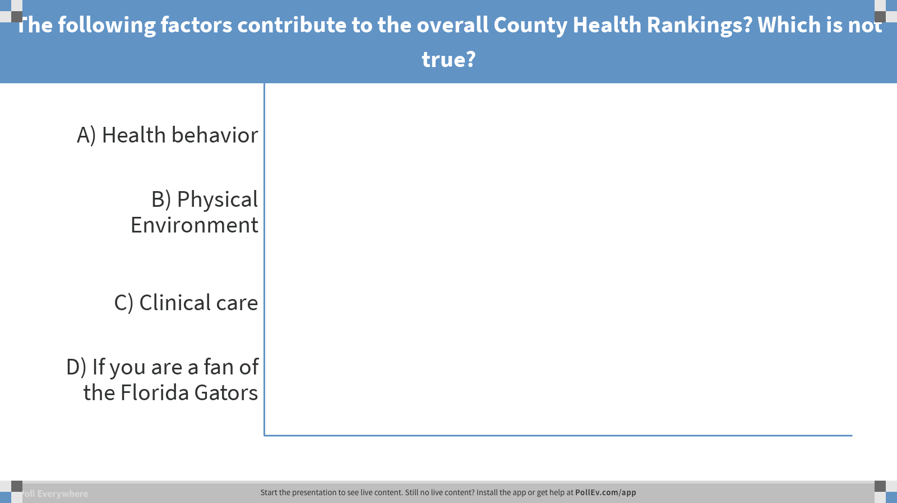
Notes:
Poll Title: The following factors contribute to the overall County Health Rankings? Which is not true?
https://www.polleverywhere.com/multiple_choice_polls/x3XMXUM048n2KFQ

Slide 12
Nassau County Health Factor Rankings 2018
County Health Rankings & Roadmaps, produced by the University of Wisconsin and Robert Wood Johnson Foundation, are a collection of reports that illustrate the overall health of counties in every state across the country and provide a comparison of counties within the same state. Two major categories exist for County Health Rankings: health outcomes and health factors.

Slide 13
Demographic Profile

Slide 14
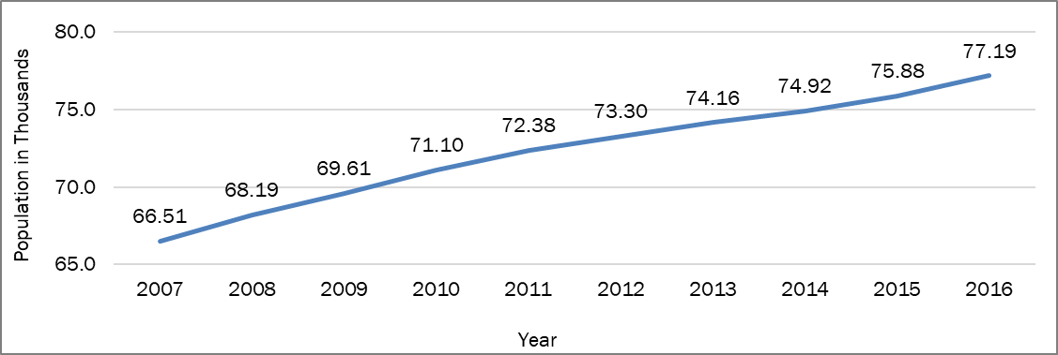
Population & Growth, 2007-2016
Nassau County and Florida had an estimated population of 77,187 and 19,934,451 respectively in 2016. From 2007 to 2016 this was a 16.% population growth. (compared to Florida at 10%)

Slide 15
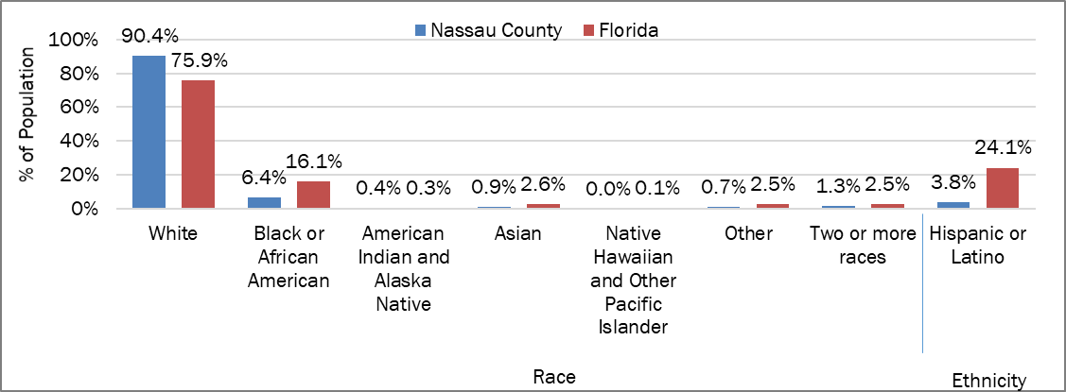
Population by Race & Ethnicity 2016

Slide 16

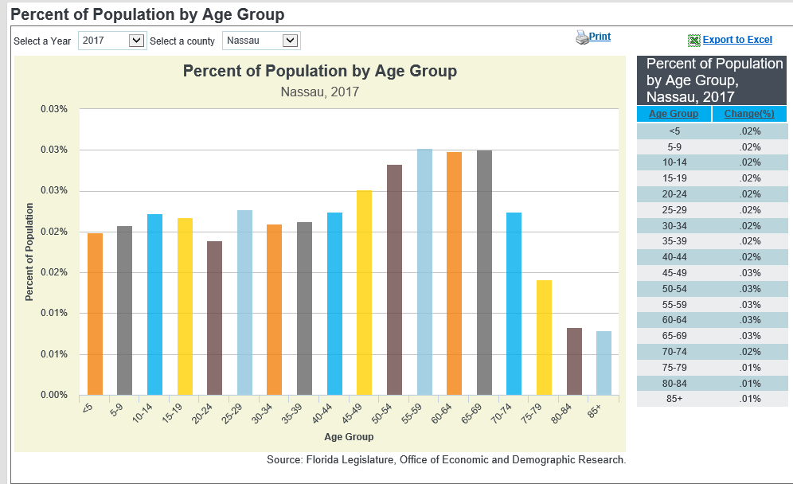
Population by Age 2017
Note: Ages
50-54 = 7.5%
55-59 = 8.3%
60-64 = 7.1%
65-69 = 7.2%
Notes:
Reference increasing over 50 demographic.

Slide 17
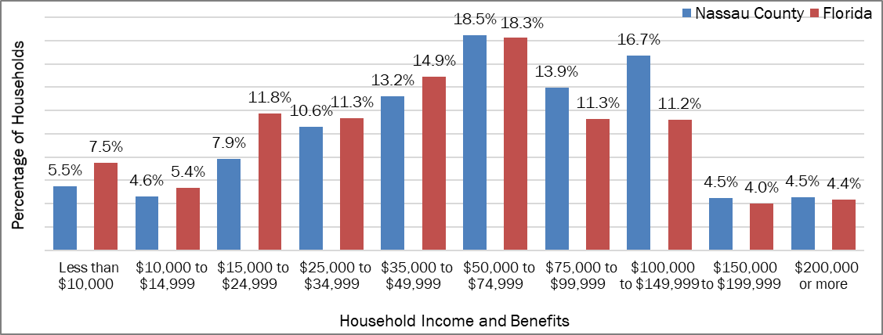
Income
Notes:
The largest portion (18.5%) of Nassau County households earned $50,000-$74,999 in income and benefits, closely followed by households earning $100,000 to $149,999 (16.7%). Households earning more than $50,000 made up 58.1% of Nassau County, compared to 49.2% of Florida households (Figure 12). Per person income was $31,141 in Nassau County and $27,598 in Florida in 2016. Mean income was $9,546 higher than Florida in 2016 and the Median
income was $10,296 higher than Florida.
U.S. Census Bureau. (2016). 2016 American Community Survey 1-Year Estimates: Table DP03-Selected Economic Characteristics [Data file]. Available from https://factfinder.census.gov

Slide 18
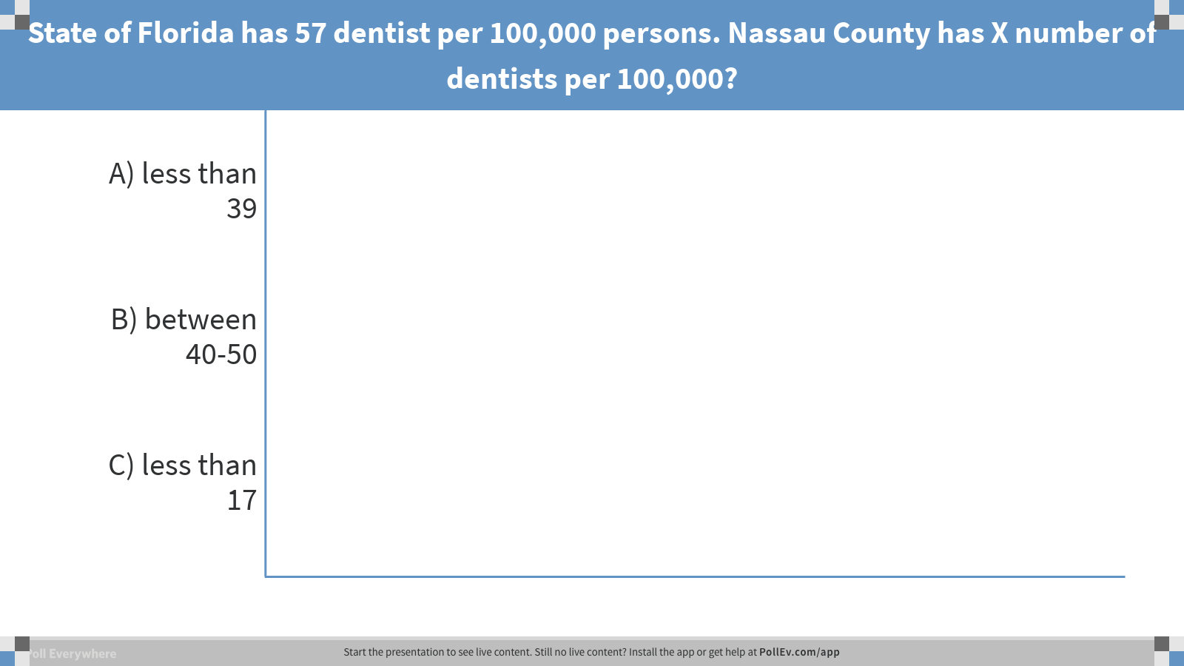
Notes:
Poll Title: What is the number of dentists in Nassau County?
https://www.polleverywhere.com/multiple_choice_polls/wxYdwp2sPN4Uj0C

Slide 19
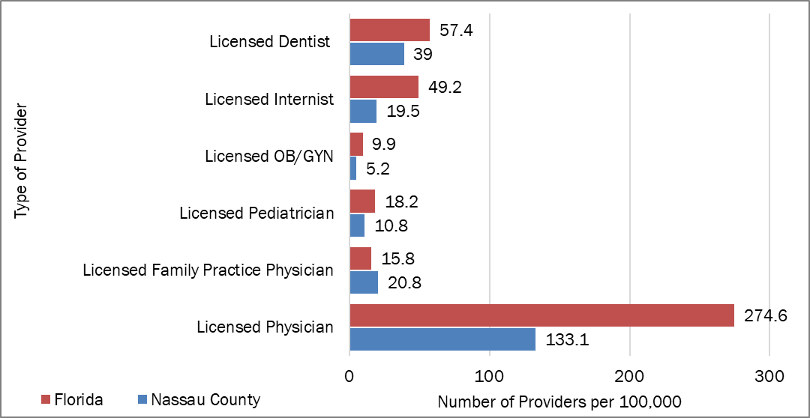
Total Licensed Providers, Nassau County 2014-2017

Slide 20
Federal Health Professional Shortage Designation
The Human Health Resources and Services (HRSA) develops a shortage designation criteria to determine whether an area or population group is experiencing a health professional shortage. Shortages can be for primary medical care, dental, or mental health provider. In 2017, Nassau County was designated a Health Professional Shortage Area (HPSA) due to lack of primary care service.
Health Resources and Services Administration. (2017, 03 30). HRSA Data Warehouse . Retrieved from https://datawarehouse.hrsa.gov/tools/analyzers/HpsaFindResults.aspx
Overall, Nassau County has a significantly lower number of licensed physicians per 100,000 people than the state average. Nassau County also has fewer licensed dentists, internists, OB/GYNs, and pediatricians per 100,000 than Florida. Nassau County has slightly more family practice physicians per 100,000 population than Florida.

Slide 21
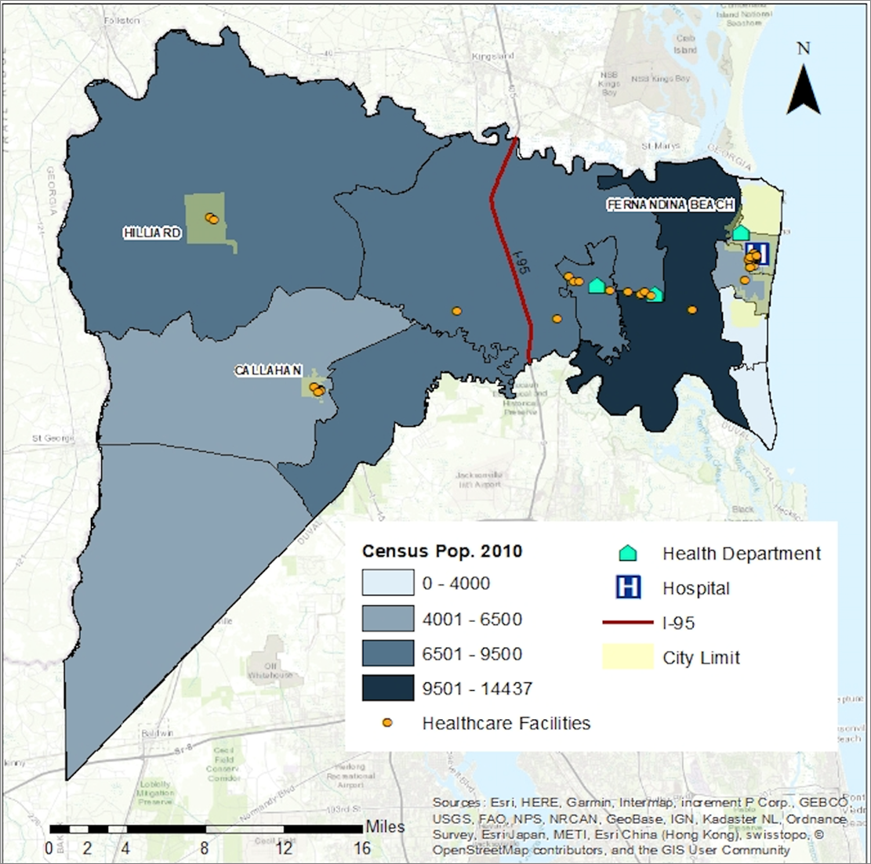
Health Resources with 2010
Census Density
Notes:
Mention Health Professional Shortage Designation – healthcare facilities are the orange dots. Not the cluster on the island and in Yulee.

Slide 22
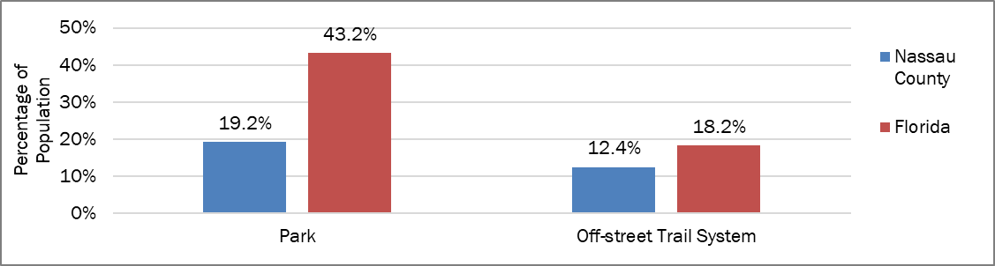
Population Living With-in Half-Mile
(or 10 Minute Walk) of Park/Trail System

Slide 23
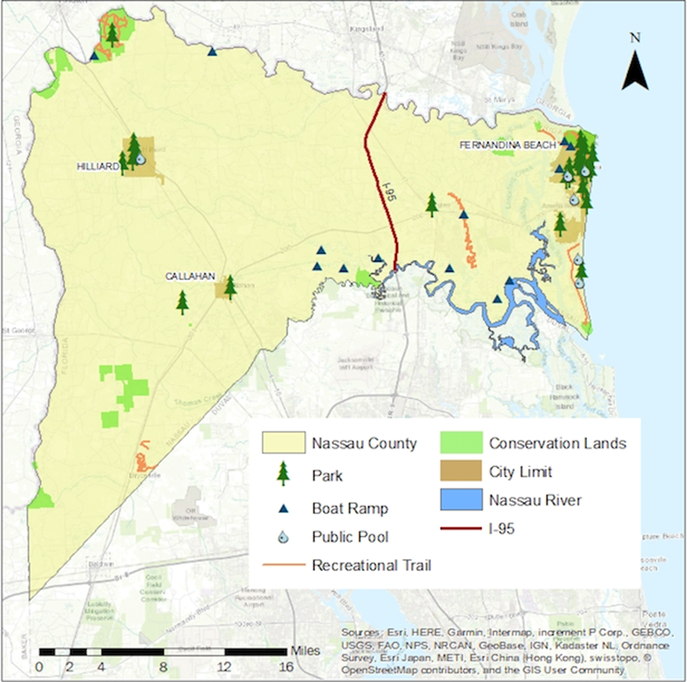
Recreational Resources March 2018

Slide 24
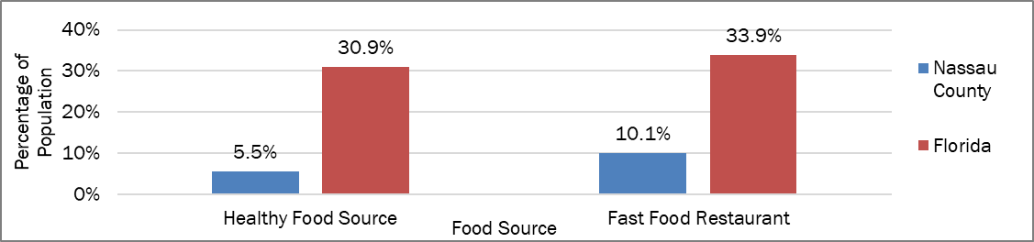
Population Living with-in Half-Mile
(or 10 Minute Walk) of Healthy Food Source or Fast Food Restaurant

Slide 25
Major Causes of Death

Slide 26
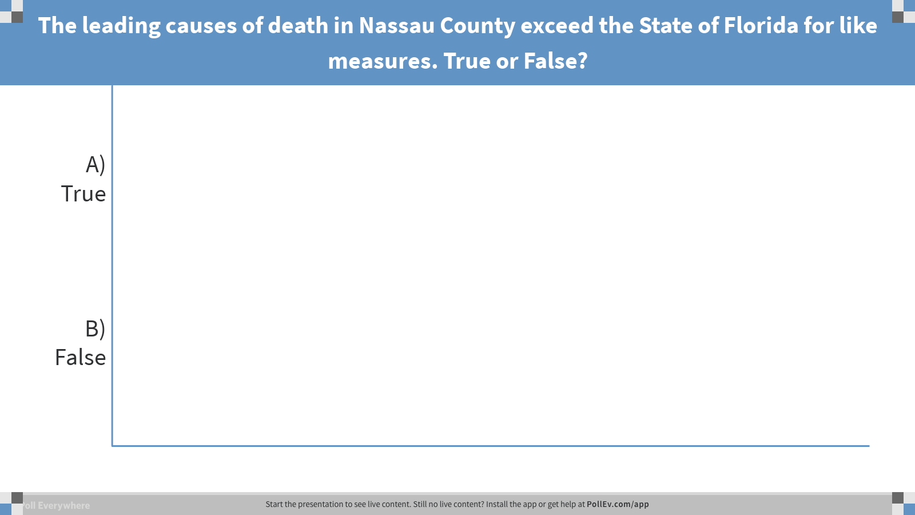
Notes:
Poll Title: The leading causes of death in Nassau county exceed the State of Florida for like measures. True or False?
https://www.polleverywhere.com/multiple_choice_polls/HjvwgPujzAPBUhV

Slide 27

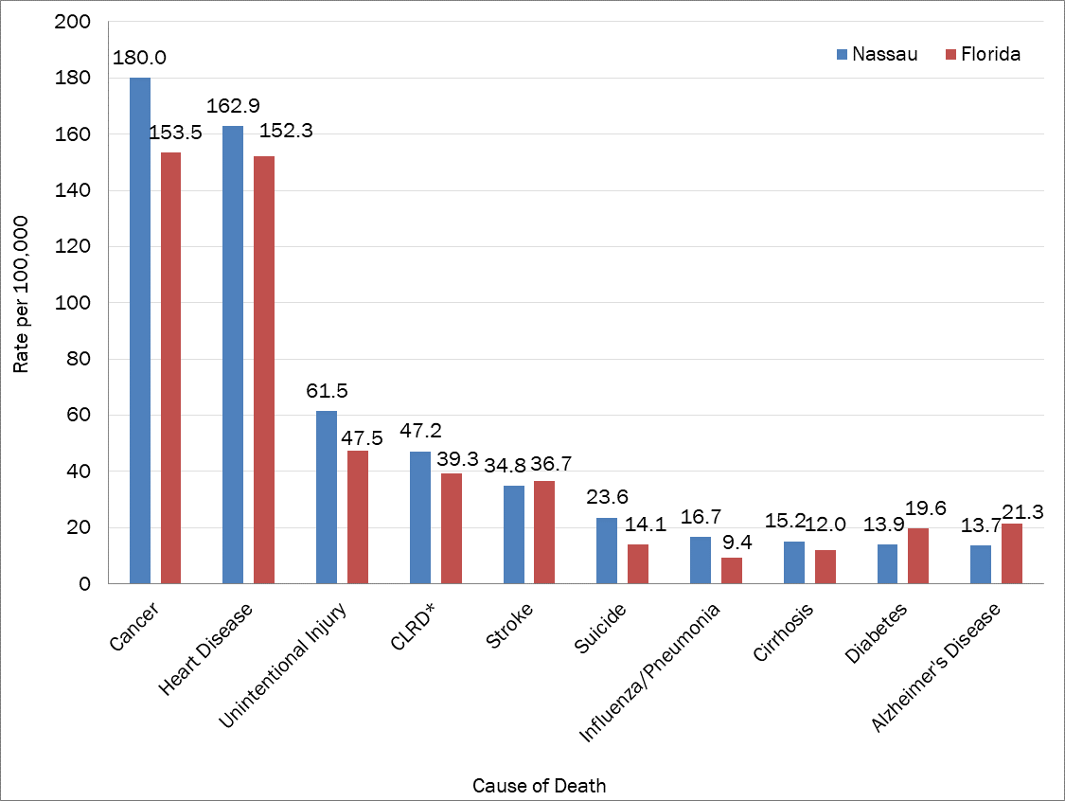

Leading Causes of Death, 2014-2016
Notes:
Figure 29 shows the top ten leading causes of death in Nassau County with a comparison to the state of Florida as a whole. Cancer, heart disease, and unintentional injury are the leading killers in Nassau County. Nassau has a higher mortality rate for cancer (180 versus 153.5 deaths per 100,000 population) compared to the three-year Florida rate. However, the death rates from stroke (36.7 versus 34.8 deaths), diabetes (13.9 versus 19.6 deaths), and Alzheimer’s disease (21.3 versus 13.7 deaths) were lower in Nassau County than the rates for Florida during the same period.

Slide 28

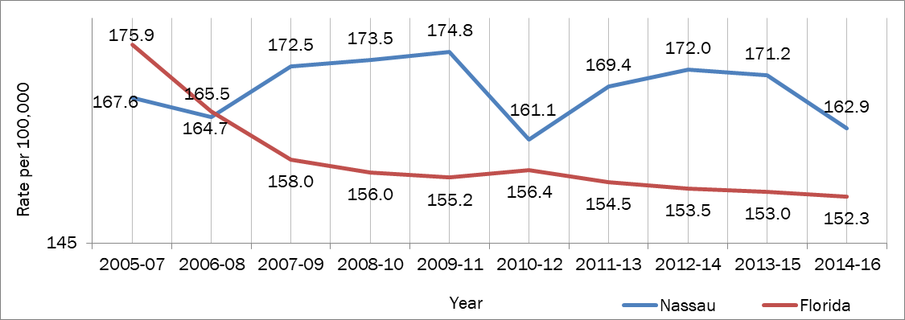
Heart Disease Mortality Rate, All Races

Slide 29
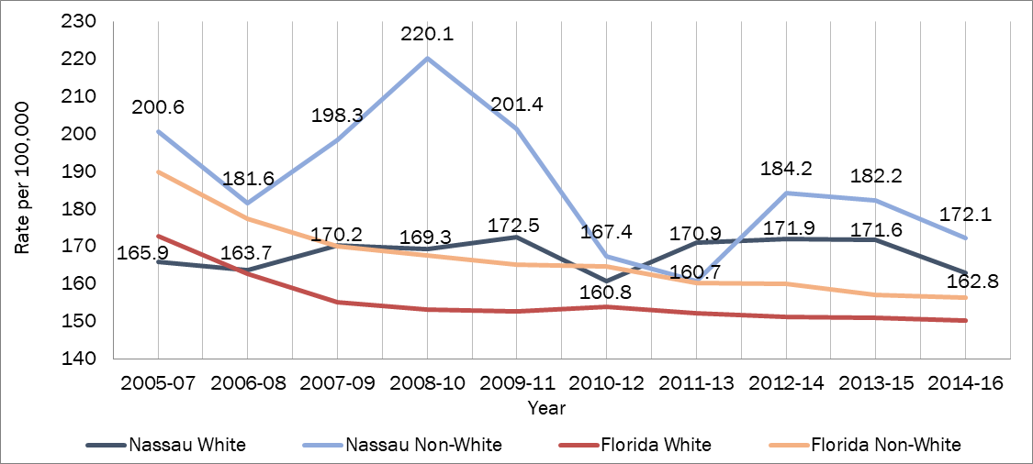
Heart Disease Mortality Rate by Race

Slide 30
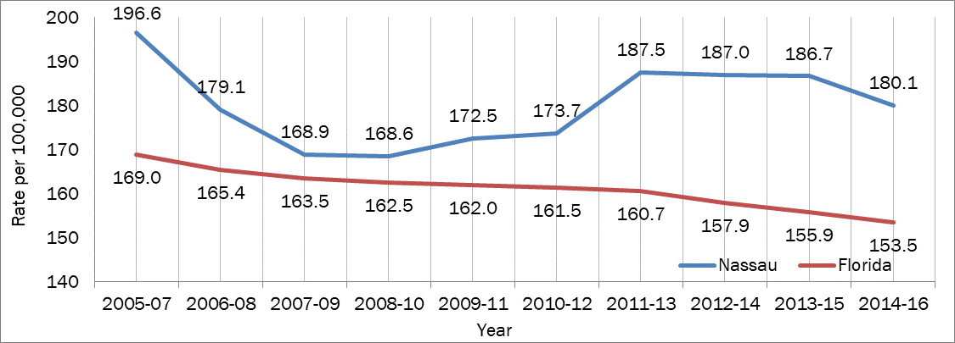
Cancer Mortality Rate, All Races
2005-2016

Slide 31
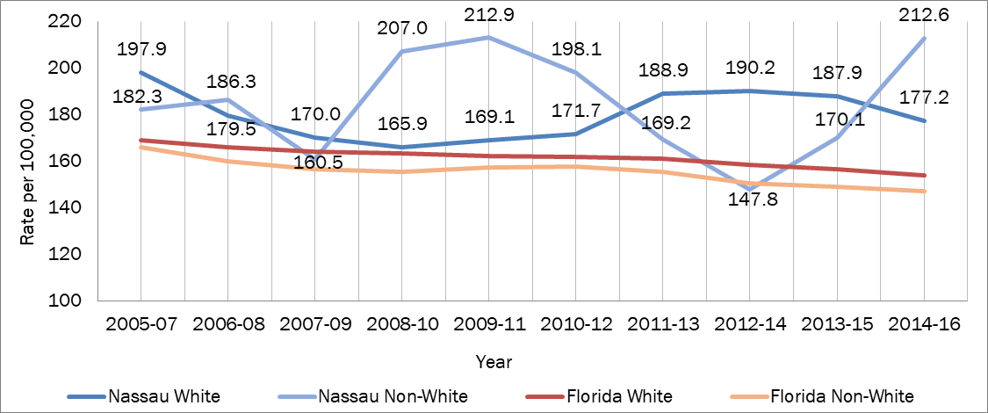
Cancer Mortality Rate by Race
2005-2016

Slide 32
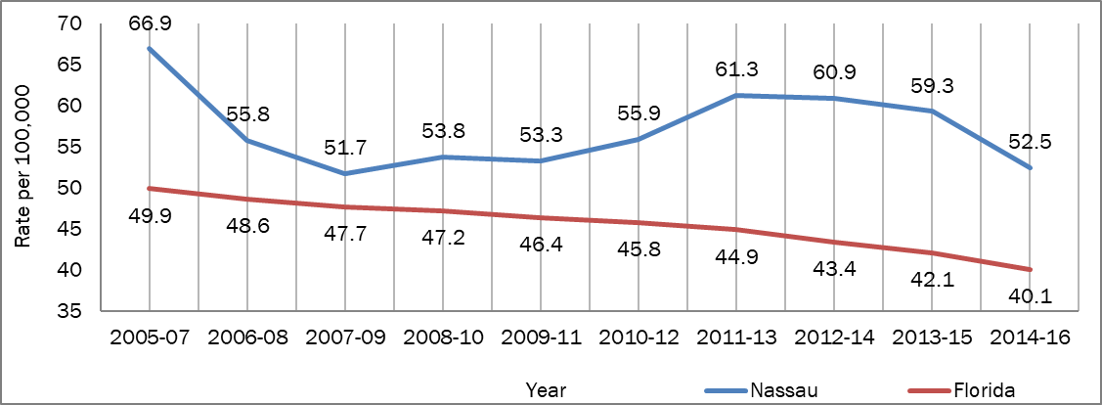
Lung Cancer Mortality Rate, All Races 2005-2016

Slide 33
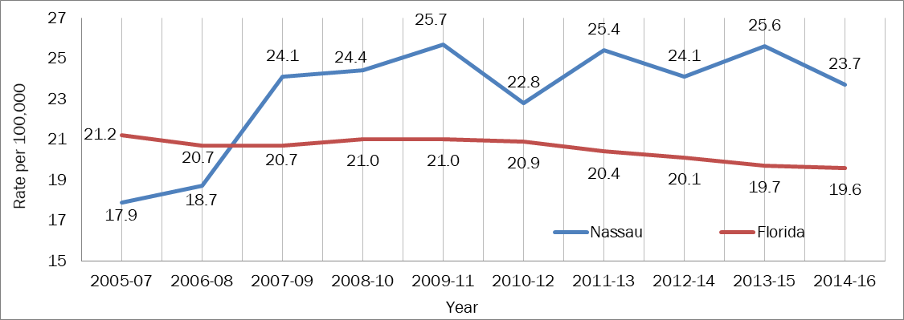
Breast Cancer Mortality Rate, All Races 2005-2016

Slide 34
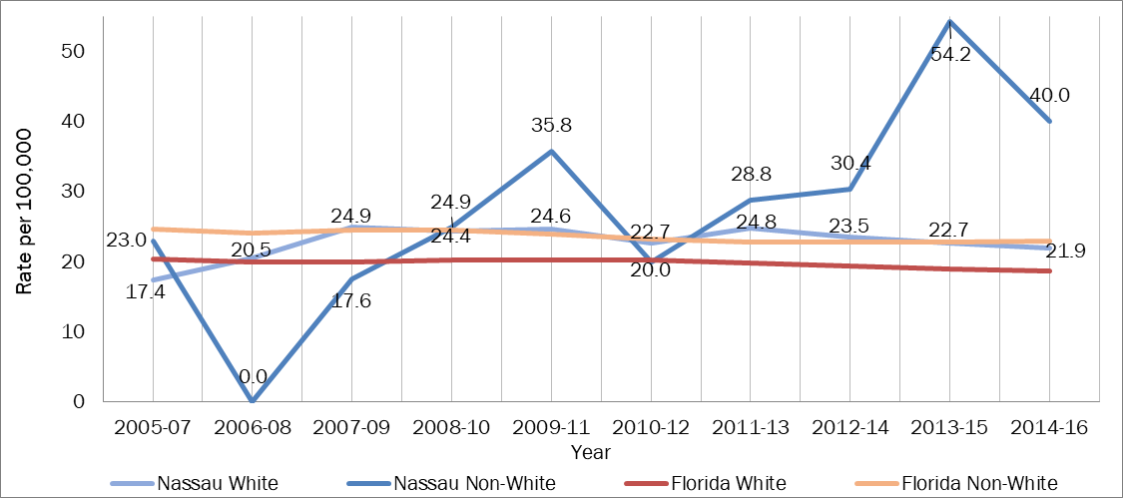
Breast Cancer Mortality Rate by Race, 2005-2016

Slide 35
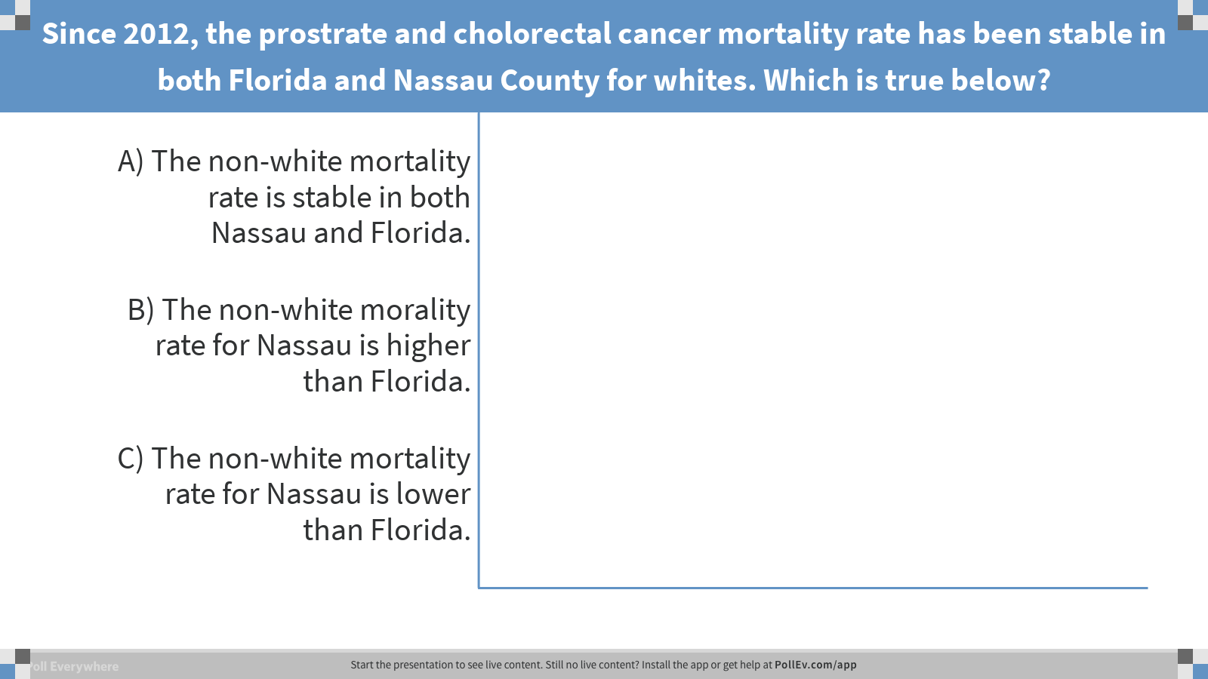
Notes:
Poll Title: Since 2012, the cholerectal cancer mortality rate has been stable in both Florida and Nassau County for whites. Which is true below?
https://www.polleverywhere.com/multiple_choice_polls/xVv40ILfVsQq9Kn

Slide 36
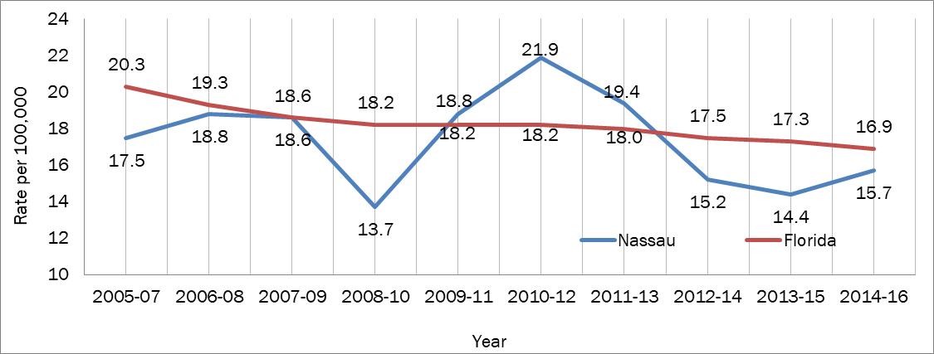
Prostrate Cancer Mortality All Races 2005-2016

Slide 37
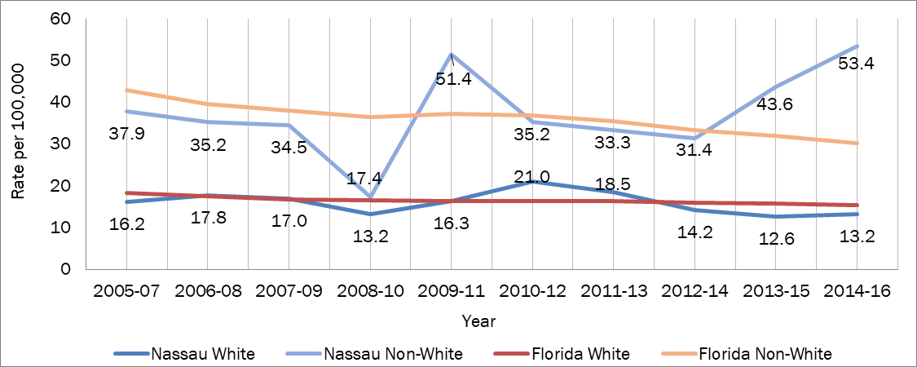
Prostate Cancer Mortality by Race, 2005-2016

Slide 38
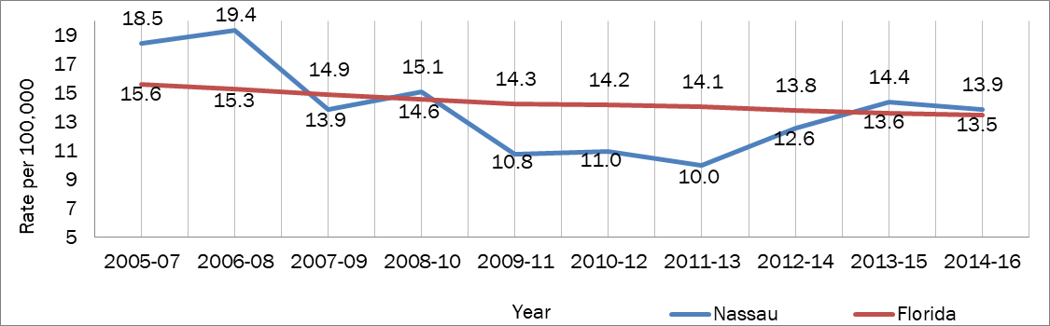
Colorectal Cancer Mortality All Races 2005-2016

Slide 39
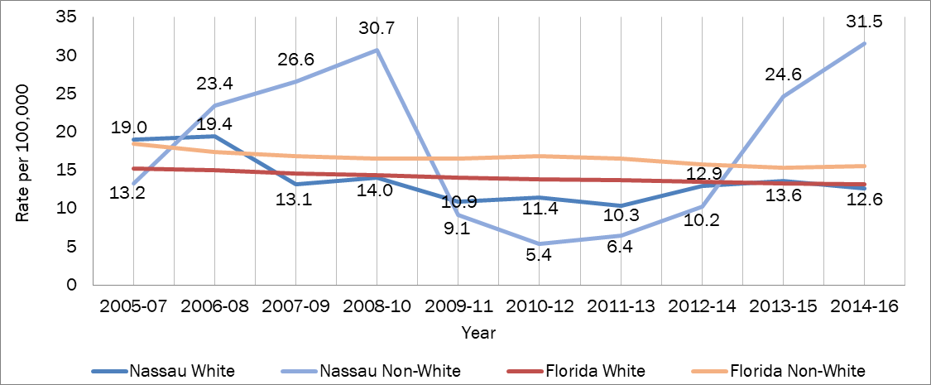
Colorectal Cancer Mortality by Race, 2005-2016

Slide 40
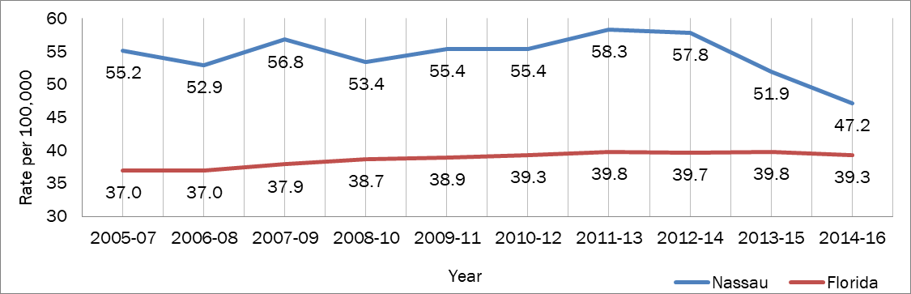
Chronic Lower Respiratory Disease Mortality Rate, All Races 2005-2016

Slide 41
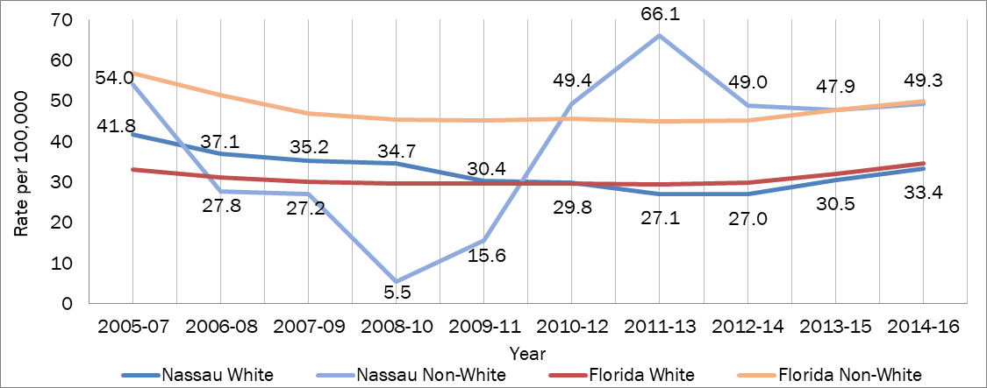
Stroke Mortality Rate by Race,
2005-2016

Slide 42
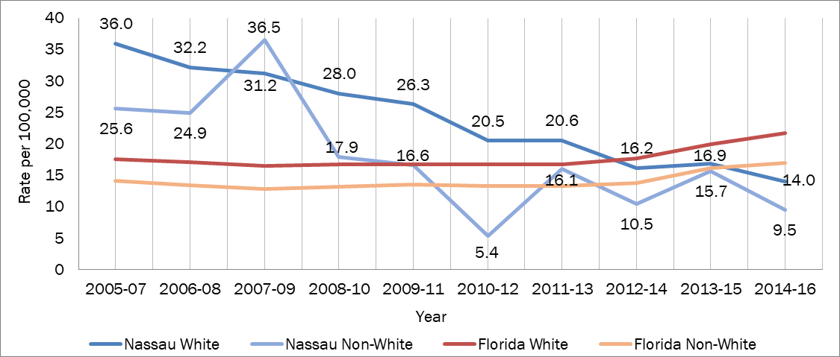
Alzheimer’s Mortality Rate by Race 2005-2016

Slide 43
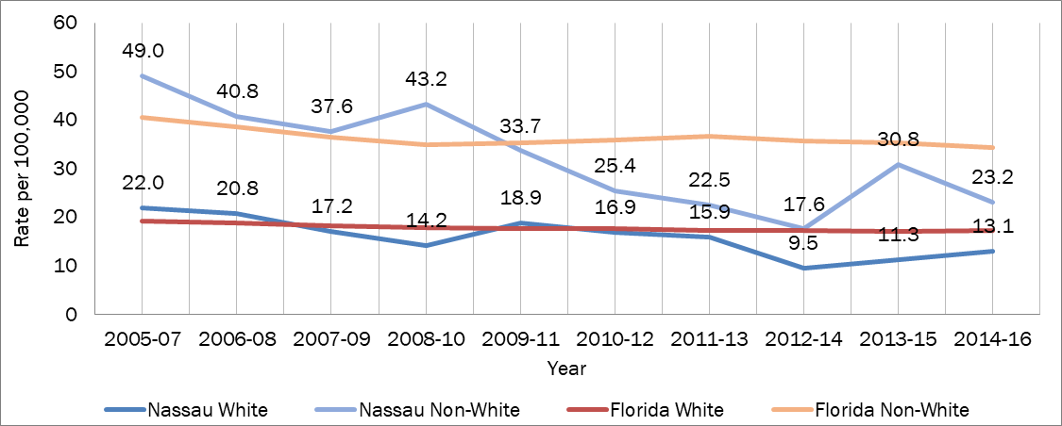
Diabetes Mortality Rate by Race
2005-2016

Slide 44
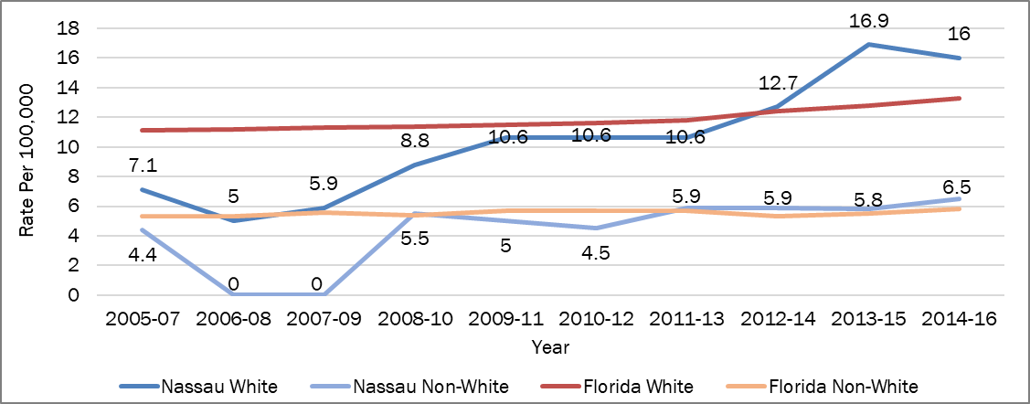
Chronic Liver Disease & Cirrhosis
Death Rate by Race 2005-2016

Slide 45
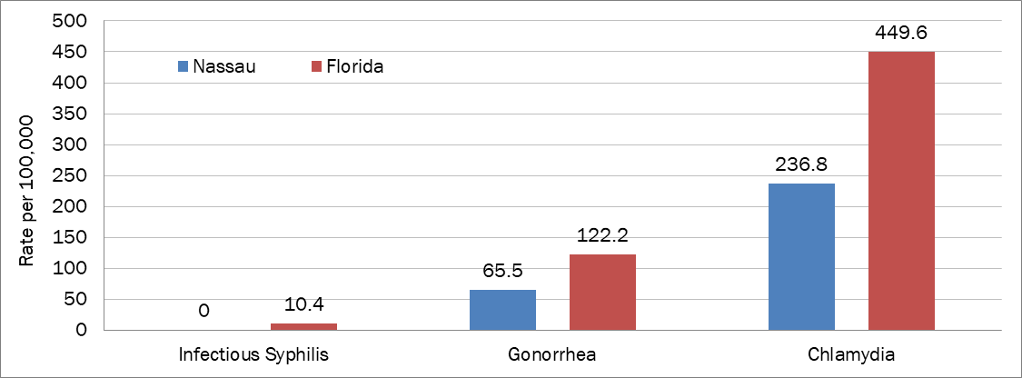
Communicable Diseases 2014-2016
Syphilis, Gonorrhea & Chlamydia Rates, 3-Year Rolling Rates, FL Health Charts

Slide 46
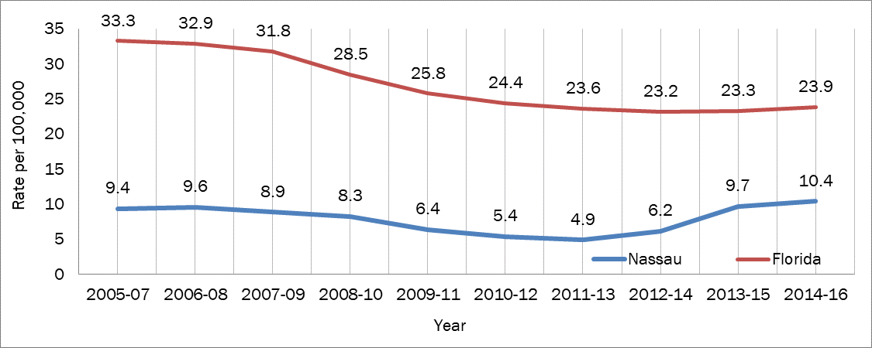
HIV/AIDS Mortality Rate 2005-2016
10.4 deaths per 100,000 is the highest in the last decade.
Notes:
Insert table on disparity data

Slide 47

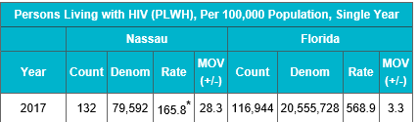
Persons Living with HIV/AIDS

Slide 48
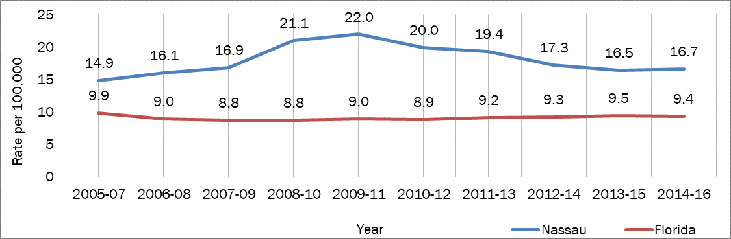
Influenza & Pneumonia Death Rate
All Races 2005-2016

Slide 49
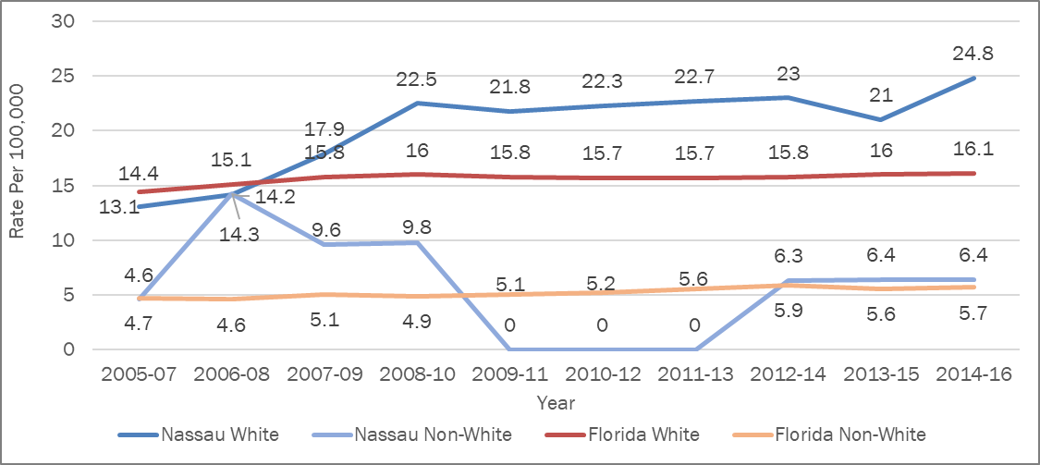
Suicide Death Rate by Race 2005-2016
Notes:
Suicide occurs when a person ends their own life and it is the 10th leading cause of death among Americans. Deaths are not the only consequence of suicide. More people survive suicide attempts than die, and suicide survivors may have serious injuries, such as broken bones, brain damage, or organ failure. Nassau County’s suicide death rate increased from 12.4 deaths per 100,000 population in 2005-07 to 23.6 deaths per 100,000 in 2014-16 (Figure 72). Suicide tends to occur much more frequently among white populations than non-white groups (Figure 73).
U.S. Centers for Disease Control and Prevention. (2015, May). Deaths. Final Data for 2013.. Retrieved from CDC.gov: http://www.cdc.gov/leadingcausesofdeath
U.S. Centers for Disease Control and Prevention. (2014, September). Preventing Suicide. Retrieved from CDC.gov: http://www.cdc.gov/Features/PreventingSuicide/

Slide 50
Florida Mental Health Act “Baker Act”
The Baker Act allows for involuntary exam initiation (also referred to as emergency or involuntary commitment). Initiations can be made by judges, law enforcement officials, physicians, or mental health professionals only when there is evidence that a person has a mental illness and is a harm to self, harm to others, or self-neglectful (as defined in the Baker Act). Examinations may last up to 72 hours and can occur in any of over 100 Florida Department of Children and Families designated receiving facilities statewide.
Florida Department of Children and Families, 2014.

Slide 51
Baker Act Initiations in Nassau County 2007-2016
Notes:
Twice the increase in law enforcement initiated Baker Acts by law enforcement. From 2012- 234 to 2017-557. Law enforcement is busy handling persons who are mentally unstable.

Slide 52
Insurance Coverage in Nassau
2012-2016
Notes:
Highlight uninsured row

Slide 53
Injury & Violence

Slide 54
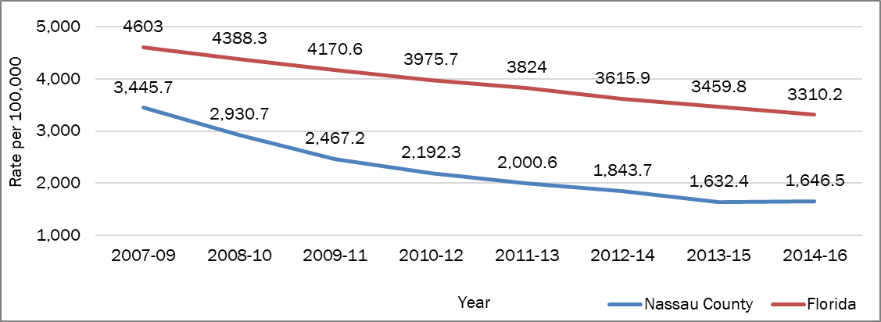
Index Crimes
Nassau County’s Index Crime rate decreased from 2007-2016 by 52%. Florida’s decreased by 28% during the same period.
Notes:
Index crimes, composed of aggravated assault, burglary, larceny, motor vehicle theft, murder, robbery, and sexual offenses, track the number of offenses reported to law enforcement and not the arrests for the given crimes. Florida Department of Law Enforcement. (2016). Crime in Florida – Clay County. Retrieved from http://www.fdle.state.fl.us/FSAC/County-Profiles/Clay.aspx

Slide 55
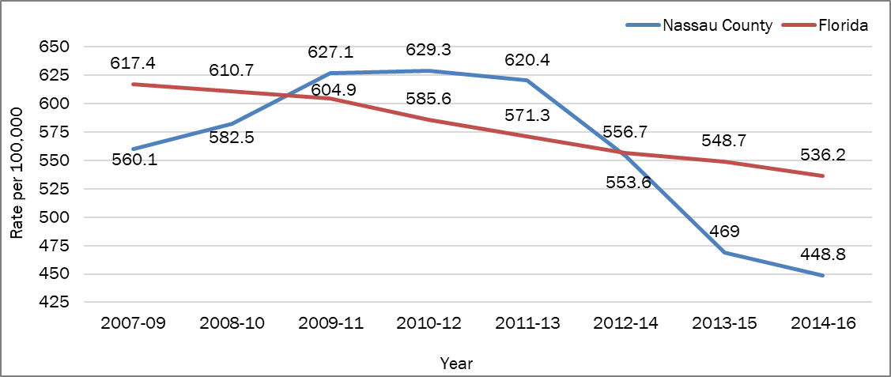
Incidence of Domestic Violence
2007-2016
Nassau County domestic violence rate decreased from by 28.7% from 2010-2016.

Slide 56
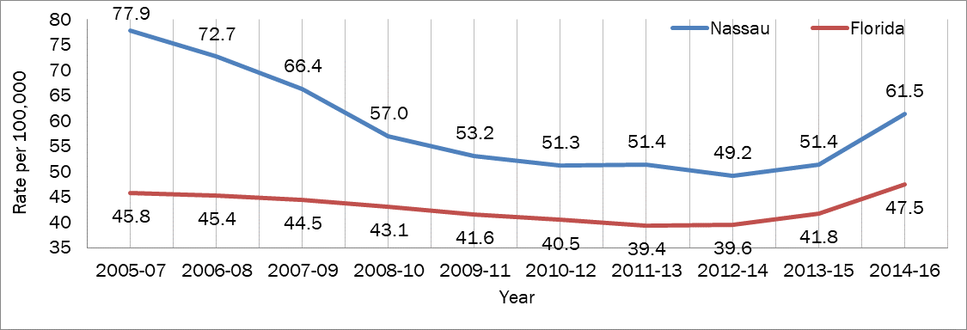
Unintentional Injury Death Rate
2005-2016
Accidental or unplanned and typically occur in a short period. Ex: drowning, motor vehicle
crashes, fires, falls and poisoning. Nassau County’s increased by 25% from 2012-2016.

Slide 57
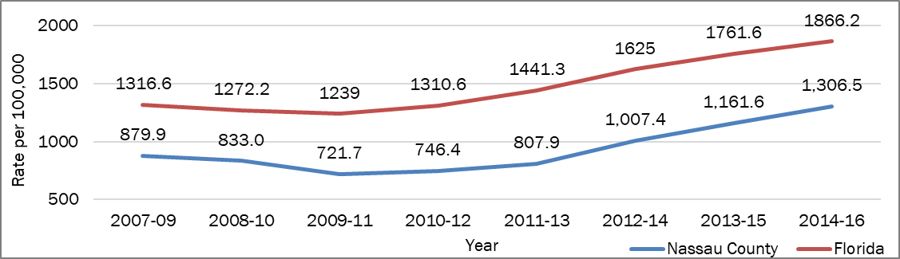
Traffic Crashes 2007-2016
Notes:
Move nearer to Injury data

Slide 58
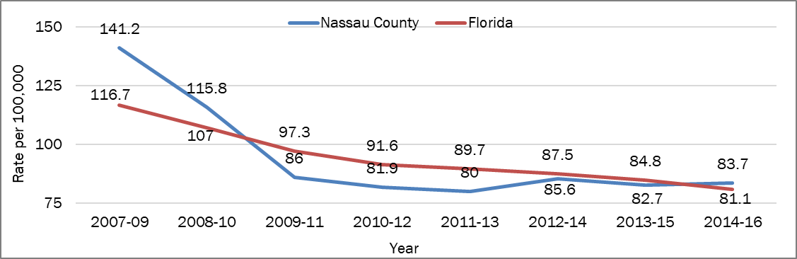
Incidence of Alcohol-Suspected Motor Vehicle Traffic Crashes 2007-2016
Nassau County saw a 42% decrease in the incidence of alcohol-suspected motor vehicle
crashes from 2007-2016.

Slide 59
Social and Behavioral Health

Slide 60
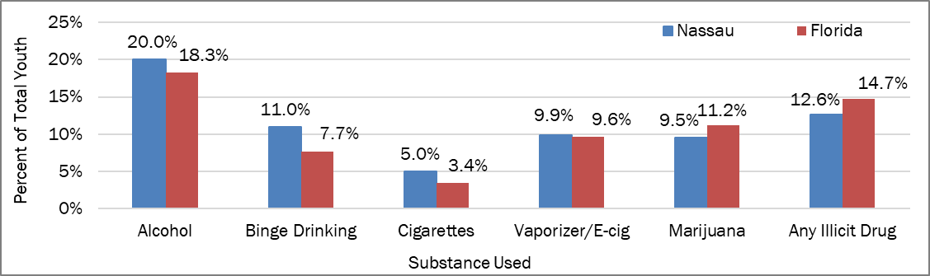
Youth Who Report Using Substances in Past 30 Days 2016

Slide 61
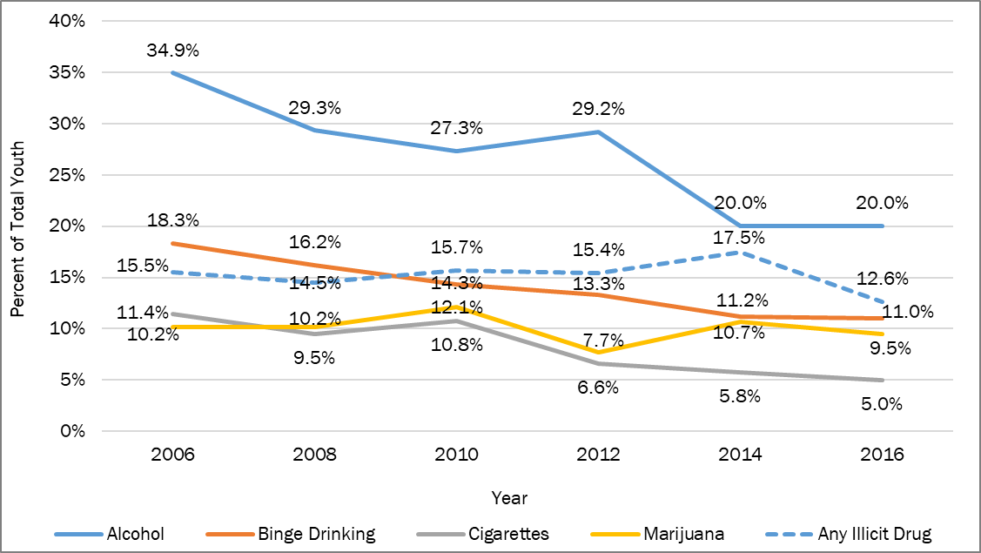
Past 30 Trend in Substance Use for Youth 2006-2016
Notes:
The 2016 FYSAS was answered by 725 Nassau County students in grades 6-12. Alcohol was the most commonly used substance among students with a prevalence rate of 43.5% for lifetime use and a prevalence rate of 20% for past 30-day use. Vaporizers and e-cigarettes were the second most commonly used substances among students, with a 28.5% prevalence rate for lifetime use and 9.9% prevalence rate for past 30-day use.

Slide 62
Maternal and Child
Health Behaviors

Slide 63
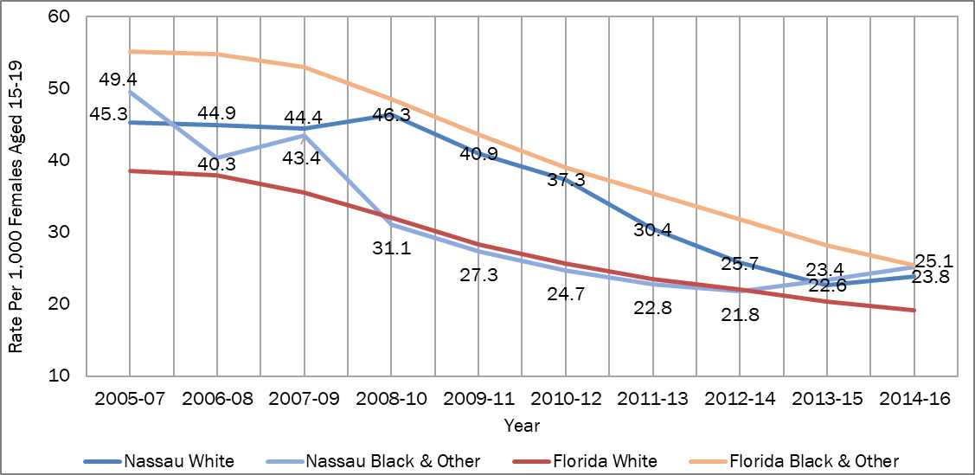
Birth Rates of Mothers 15-19 by Race 2005-2016

Slide 64
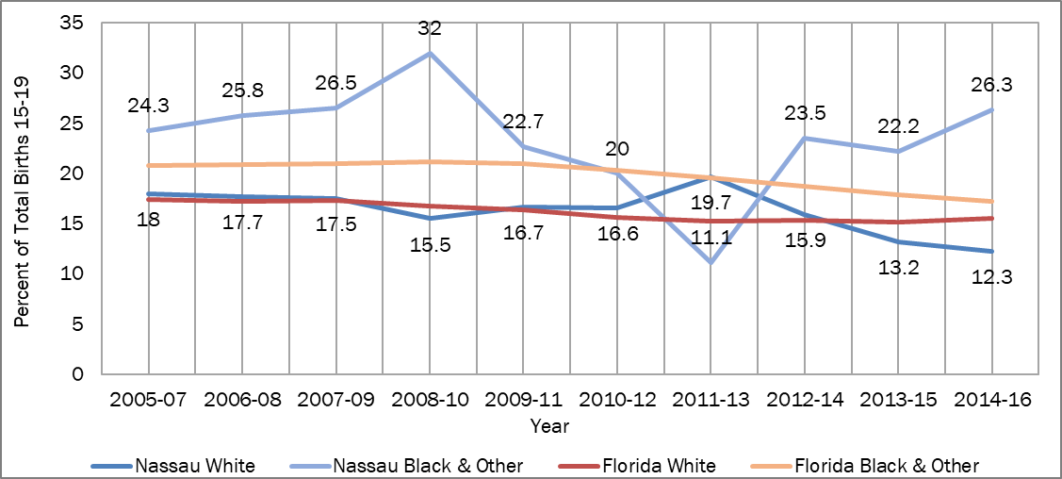
Repeat Birth Rate of Mothers
Ages 15-19 by Race
Notes:
Infant mortality is the death of a live-born baby within the first year of life. The infant mortality rate is the number of infant deaths for every 1,000 live births. This rate is an important marker of the overall health of a society.⁵ Nassau County experienced an increase in the infant mortality rate for all races from 2006-08 to 2009-11, but remained below the Florida rate from 2011-13 to 2014-16 (Figure 66). White infant mortality rates are consistently lower than non-White rates in Nassau County. In 2014-16, Nassau’s white population had an infant mortality rate of 4.2 deaths per 1,000 live births compared to 14.4 deaths per 1,000 live births in the non-White population (Figure 67).
⁵ Centers for Disease Control and Prevention. (2018). Infant Mortality. https://www.cdc.gov/reproductivehealth/maternalinfanthealth/infantmortality.htm

Slide 65
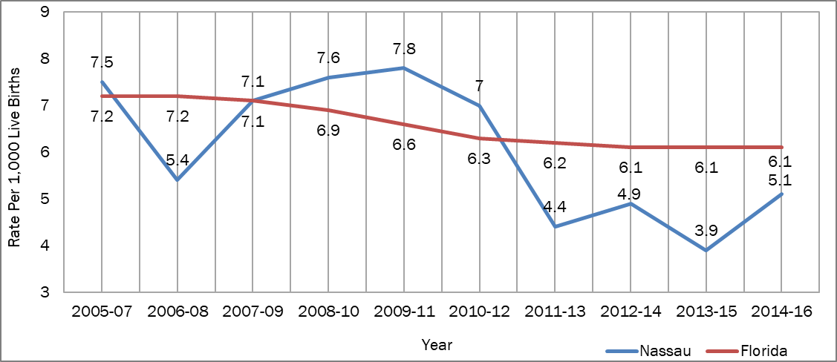
Infant Mortality Rate – All Races
Notes:
Infant mortality is the death of a live-born baby within the first year of life. The infant mortality rate is the number of infant deaths for every 1,000 live births. This rate is an important marker of the overall health of a society.⁵ Nassau County experienced an increase in the infant mortality rate for all races from 2006-08 to 2009-11, but remained below the Florida rate from 2011-13 to 2014-16 (Figure 66). White infant mortality rates are consistently lower than non-White rates in Nassau County. In 2014-16, Nassau’s white population had an infant mortality rate of 4.2 deaths per 1,000 live births compared to 14.4 deaths per 1,000 live births in the non-White population (Figure 67).
⁵ Centers for Disease Control and Prevention. (2018). Infant Mortality. https://www.cdc.gov/reproductivehealth/maternalinfanthealth/infantmortality.htm

Slide 66
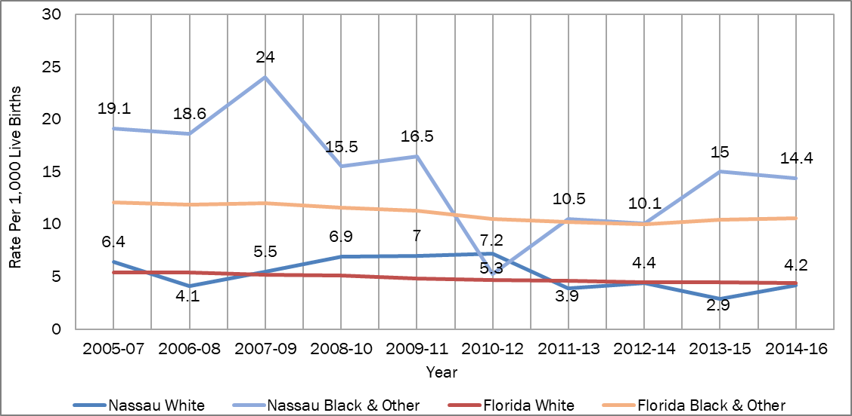
Infant Mortality Rates by Race
Notes:
Infant mortality is the death of a live-born baby within the first year of life. The infant mortality rate is the number of infant deaths for every 1,000 live births. This rate is an important marker of the overall health of a society.⁵ Nassau County experienced an increase in the infant mortality rate for all races from 2006-08 to 2009-11, but remained below the Florida rate from 2011-13 to 2014-16 (Figure 66). White infant mortality rates are consistently lower than non-White rates in Nassau County. In 2014-16, Nassau’s white population had an infant mortality rate of 4.2 deaths per 1,000 live births compared to 14.4 deaths per 1,000 live births in the non-White population (Figure 67).
⁵ Centers for Disease Control and Prevention. (2018). Infant Mortality. https://www.cdc.gov/reproductivehealth/maternalinfanthealth/infantmortality.htm

Slide 67
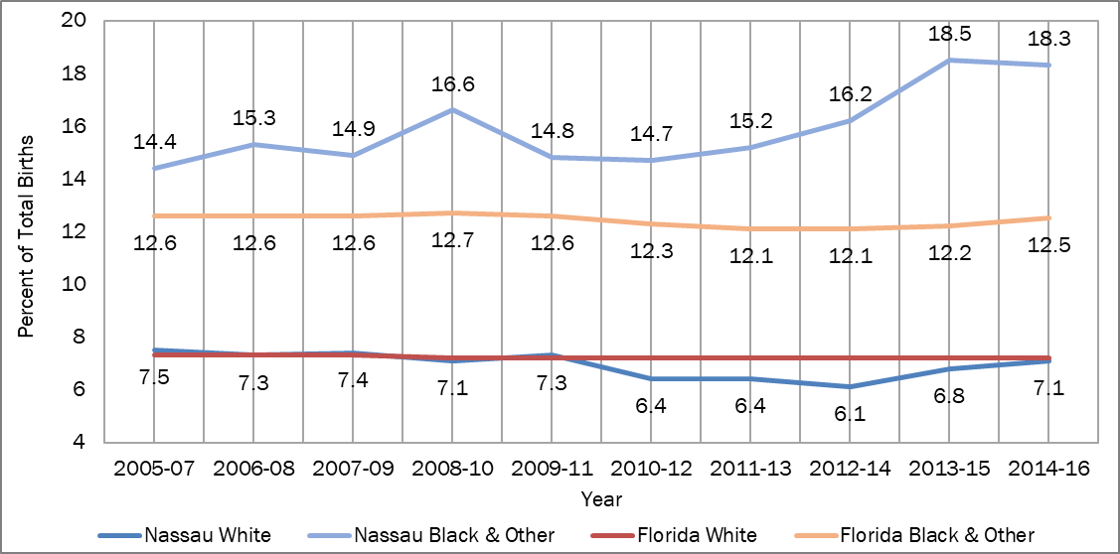
Percent of Total Births with Low Birth Weight by Race
Notes:
Infant mortality is the death of a live-born baby within the first year of life. The infant mortality rate is the number of infant deaths for every 1,000 live births. This rate is an important marker of the overall health of a society.⁵ Nassau County experienced an increase in the infant mortality rate for all races from 2006-08 to 2009-11, but remained below the Florida rate from 2011-13 to 2014-16 (Figure 66). White infant mortality rates are consistently lower than non-White rates in Nassau County. In 2014-16, Nassau’s white population had an infant mortality rate of 4.2 deaths per 1,000 live births compared to 14.4 deaths per 1,000 live births in the non-White population (Figure 67).
⁵ Centers for Disease Control and Prevention. (2018). Infant Mortality. https://www.cdc.gov/reproductivehealth/maternalinfanthealth/infantmortality.htm

Slide 68
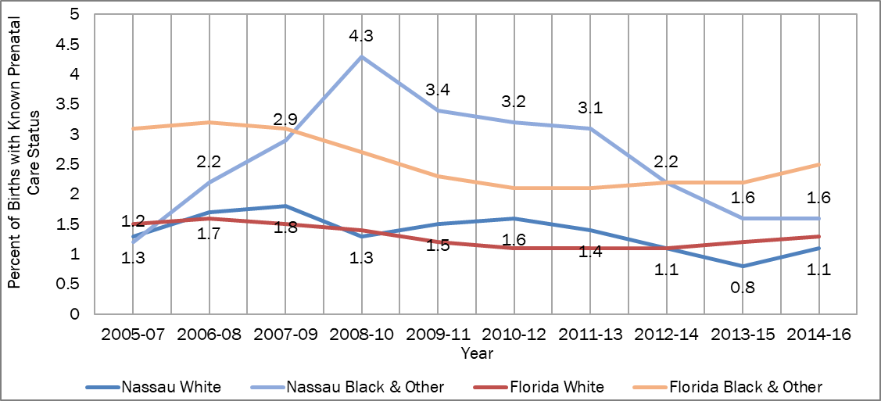
Percent of Births to Mothers with No Prenatal Care by Race
Notes:
Infant mortality is the death of a live-born baby within the first year of life. The infant mortality rate is the number of infant deaths for every 1,000 live births. This rate is an important marker of the overall health of a society.⁵ Nassau County experienced an increase in the infant mortality rate for all races from 2006-08 to 2009-11, but remained below the Florida rate from 2011-13 to 2014-16 (Figure 66). White infant mortality rates are consistently lower than non-White rates in Nassau County. In 2014-16, Nassau’s white population had an infant mortality rate of 4.2 deaths per 1,000 live births compared to 14.4 deaths per 1,000 live births in the non-White population (Figure 67).
⁵ Centers for Disease Control and Prevention. (2018). Infant Mortality. https://www.cdc.gov/reproductivehealth/maternalinfanthealth/infantmortality.htm

Slide 69
Health Disparities
Elevating the Social Determinants of Health
Ensuring the right to health by:
  Creating conditions that enable good health
  Acknowledging the inequities that perpetuate poor health
  Considering health in all policies
Example: Communities that improve neighborhood sidewalks help encourage physical activity; better product labeling can help people eat healthier; and boosts in the minimum wage can result in more babies being born at a healthy weight and fewer infant deaths.
Becoming the healthiest nation requires a commitment to achieving “health place matters”.
Did you know that in Nassau County, there is a difference in average life expectancy depending upon where you live. With a range of 74.7 years at the lower end and 88.1 years at the higher end.

Slide 70



Life Expectancy and Economic Hardship Index
Yulee
South end of
Amelia Island
Notes:
List factors for EHI - INSERT SUMMARY REFERENCING CHSA FACT SHEET

Slide 71
Summary of Community Health Assessment Data
There are health disparities in the areas of:
  Cancer (breast, colorectal, prostrate
  Heart Disease
  Infant Mortality
  Low Birth Weight
  Repeat Teen Births
  Chronic Diseases (Stroke/Diabetes)
  HIV (County Health Rankings)
Physical Environment – less than 12% of residents live within a 10 minute walk of a safe place to exercise.
Medical Professional Shortage continues with growing community.
Increase in Suicide (white) and Baker Act examinations
Increase in Unintentional Injury Death rate
Increase in Traffic Crashes
Life Expectancy varies (location)

Slide 72
Additional summary thoughts:
Population Growth of 6.3% from 2016-2017: 80,456
Decrease in Index Crime Rate 52%
Decrease in Domestic Violence by 28%
Decrease in Alcohol-Suspected Motor Vehicle Traffic Crashes
Appearance of downward trend for Youth using Substances

Slide 73
Community Themes and Strengths Assessment
Most important feature of a healthy community: English
Access to Healthcare 87%
Low Crime/Safe Neighborhoods 87%
Clean and Healthy Environment 84%
Quality Jobs 81%
Most Important features of a healthy community: Hispanic
Access to Healthcare 94%
Clean and Healthy Environment 89%
Access to Educational Opportunities 88%
Quality Jobs 76%
Notes:
Surveys were completed by 535 English speaking and 18 Hispanic. They were distributed across the county to businesses, to agencies, at health fairs, and online.

Slide 74
Community Themes and Strengths Assessment
Highest scoring Health Concerns: English
Abuse/Neglect 76%
Domestic Violence 73%
Mental Health 72%
Cancer 67%
Infant Health 66%
Highest scoring Health Concerns: Hispanic
Abuse/Neglect 94%
Dental 89%
Maternal and Infant Health 88%
Domestic Violence 87%
Mental Health 87%

Slide 75
Community Themes and Strengths Assessment
Services that are hard to obtain: English
Specialty Medical Care
Alternative Therapy
Substance Abuse Services
Mental health counseling
Access to Healthy Food Options
What keeps you from getting medical care:
Can’t afford appointments 43%
Lack of evening/weekend hours 43%
Services that are hard to obtain: Hispanic
Family Planning/Birth Control
Specialty Medical Care
Physical Rehabilitation Therapy
Lab Work/Imaging/X-rays
Vision/Dental
What keeps you from getting medical care:
Can’t afford appointments 88%
Don’t have transportation 69%

Slide 76
Community Themes and Strengths Assessment
English:
Where do you get your medication:
Drug Store 84%
Over the counter medication 18%
How do you dispose of unused medication:
Still in my cabinet 37%
Throw in trash 30%
Flush down toilet 27%
Use medication drop off box 19%
Hispanic:
Where do you get your medication:
Drug Store 80%
Over the counter medication 30%
How do you dispose of unused medication:
Still in my cabinet 25%,
Flush down toilet 38%,
Throw in trash 63%,
Use medication drop off box 0%.

Slide 77
Community Themes and Strengths Assessment
Where would you go if you were sick and needed medical care? English
Primary Care Doctor 71%
Emergency Room 30%
Urgent Care 22%
Where would you go if you were sick and needed medical care? Hispanic
Emergency Room 78%
Health Department 10%
Primary care doctor 10%

Slide 78
Community Themes and Strengths Assessment
English:
Gender: 80% female, 20% male
Race: 88% White, 8% Black, 4%
Ages:
10% 18-25
32% 26-39
26% 40-54
16% 55-64
11% 65-74
Education level:
35% High School
23% Community College/Tech
20% 4 year college
12% Graduate School
6% Post-Graduate studies
Employment: 56% fulltime, 12% part-time, 21% retired, 8% unemployed

Slide 79
Community Themes and Strengths Assessment
Hispanic:
Gender: 78% female, 22% male
Ages:
10% 18-25
70% 26-39
20% 40-54
Income: 66% under $19,000
Education level:
80% Elementary/Middle School
10% High School
10% Four year college
Employment:
56% fulltime
11% part-time
22% unemployed
11% homemaker

Slide 80

Local Public Health Assessment

Slide 81

Local Public Health Assessment
This pie chart shows the composite measures across all of the Essential Service Model Standards in Nassau were at the Optimal level at 80% (improved from 60% in 2015), significant level for 10% and Moderate level for 10%. Areas for improvement ES10 Research/Innovations, ES8 Assuring Workforce and ES3 Educate/Empower.
Notes:
Following this slide – insert trend results of LPHSA, potential prioritization slide?

Slide 82
Local Public Health Assessment
Trend data

Slide 83

Local Public Health Assessment Summary

Slide 84
Forces of Change Assessment
Convened two community meetings
  Fernandina Beach Chamber of Commerce location
  Yulee Family Support Services office
  attempted Callahan (unsuccessful)
Answered these questions:
  What is occurring that affects the health of our community
  What specific threats or opportunities are generated by these occurrences?
  Lots of discussion and ideas captured

Slide 85

Wildlight/Yulee –
Expansion and Resources

Slide 86

Forces of Change Assessment
Notes:
The information was collected in the following manner and put into categories of Forces, Threats and Opportunities created. It was then further expanded into the areas of economic, environmental, political, scientific/technological and social. All ideas were gathered from the attendees of the two meetings. About 30 persons in total.

Slide 87

Forces of Change Assessment

Slide 88
Forces of Change Summary
Threats:
Rapid expansion of Yulee, schools, neighborhoods
Road construction/lack of parks and safe walk ways/bike paths
Increase in Suicide, Baker Acts, lack of affordable mental health care
Increase in substance use related deaths
Lack of medical providers
Limited resources for Spanish speaking families
Increased gun violence
Opportunities:
Need new infrastructure (create City of Yulee) to support growth, tax base
Need safe roads for travel, walking/bike paths for safe exercise
Increased education and services for persons with mental health, depression.
Training for substance abuse screening/referral and local drug abuse treatment.
Increase in medical providers to care for growing population.
Expand service options for Hispanic families through common language
Training on Active Shooter

Slide 89
Prioritization of Key Issues
What are the most concerning health issues?
What do we want to change?

Slide 90
How are We Gathering Your Feedback?
Review Posters with Identified Concerns
Add additional ideas
Use dot-mocracy process
  6x Green - 3 for Most Important, 2 for Second, and 1 least
  4x Red – where we have the most influence, control and resources
Group Discussion
Reporting/Discussion

Slide 91
New Health Issues for 2019-2021
After voting at this meeting on 9/26/18:
Housing and Healthy Places
Access to Care
Behavioral Health and Substance Abuse
Health Disparities
Community Support

Slide 92
Importance and Influence/Resources

Slide 93


Where to find Summary of Key Findings and CHIP - http://nassau.floridahealth.gov/

Slide 94
Welcome and Gratitude
Acknowledgements to PHN Steering Committee:
Baptist Medical Center Nassau*- Mary Snyder
Barnabas Center - Barbara Baptista
Family Support Services - Lisa Rozier
Florida Department of Health Nassau – Eugenia Ngo-Seidel
Florida Psychological Associates - Kerrie Albert
Nassau, Alcohol, Crime Drug Abatement Coalition - Karrin Clark
Nassau County School District* - Kim Clemons
NassauTRANSIT - Mike Hays
Starting Point Behavioral Health - Valerie Ray
State Attorney’s Office - Renae Lewin
* Successor to be determined

